Slide 1
What Every Developer Should Know about F#
Kathleen Dollard
Principal Program Manager, Microsoft
@KathleenDollard

Slide 2
Learn about functions and data which lie at the heart of all programming and alternatives to how you think about programming. You’ll leave ready to experiment with F# and to apply the universal lessons exposed by F# to programming in any language.

Slide 3

Why learn about F#?

Slide 4
F# is based on decades of how programming works
OO is based on how people work. F# has both
Along with .NET runtime
And evolving tools
And…

Slide 5
.NET Interoperability
“as” patterns
Active patterns
Additional numeric types with unit annotations
Agent programming
Anonymous types
Applicative Computation Expressions
Array slicing
Asynchronous programming
Auto-properties
Byref returns, consuming C# uses and producing
Caller info argument attributes
CLIMutable attribute
Collection functions
Computation expressions (both yield and custom operations)
Discards on use bindings
Discriminated unions
Enhanced Slicing
Enumeration cases emitted as public
Extended #if grammar
Extension members
Extension method support for 'byref<'T>'/'inref<'T>'/'outref<'T>'
Extension property initializers
Extensions to array slicing
F# quotations improvements
Formatting for binary numbers
Imperative programming
Implicit conversions, consuming (from C#) and creating (with optional warnings)
Implicit "Module" syntax on modules with shared name as type
Implicit integer conversions
Implicit upcasts
Implicit yields
Improved compiler analysis for library authors
Improved Map and Set performance in FSharp.Core
InlineIfLambda optimizer directive
'IsByRefLike' structs
'IsReadOnly' structs
LINQ query expressions
Map has Keys and Values
'match!' keyword in computation expressions
Modules
Multiple interface implementation
Mutually referential types and modules within the same file
Named arguments
Named union type fields
'nameof' function
Native interoperability
NativePtr intrinsics
Nested modules
Non-null provided types
Object-oriented programming
Open static classes
Open Type declarations
Option type
Optional arguments
Optional type args
Package references in F# scripts
Params dictionaries
Pattern matching
Primary constructors as functions
Printf interpolation
Printf on unitized values
Quotations
Records (and record structs)
Result type and basic Result functions
Resumable code
Scripting files
Sequence expressions
Signature files
Static parameters for provided methods
String Interpolation
Struct annotations for Single-case Discriminated Unions
Struct tuples which inter-operate with C# tuples
Structs
Support for 'fixed'
Support for Jupyter, nteract, and VSCode Notebooks
Support for nameof
Support for 'Span<T>' and related types
Tailcall attribute
Tasks
The 'inref<'T>' and 'outref<'T>' types to represent readonly and write-only 'byref's
The 'voidptr' type
Triple-quoted strings that can contain most characters (punctuation, etc)
Tuples
Type abbreviations
Type inference
Type providers
Underscores in numeric literals
Units of measure

Slide 6
F# is based on decades of how programming works
The basic shape of the language is stable
across re-platforming and many new features
OO is based on how people work. F# has both
Along with .NET runtime
And evolving tools
And…

Slide 7
F# is based on decades of how programming works
The basic shape of the language is stable
across re-platforming and many new features
OO is based on how people work. F# has both
Along with .NET runtime
And evolving tools
F# is function based, there are no statements

Slide 8
F# is
Succinct, robust, performant
Leverages the power of .NET
Pragmatic
Multi-paradigm: functional, OO and imperative
Supported on FSI, .NET Interactive, and Jupyter
A few special features
Range of functional programming support
Computation expressions
In-lining for high performance
Units of measure
For testimonials, see https://fsharp.org/testimonials/

Slide 9
A little history
Procedural
Object oriented
Functional
Metaprogramming

Slide 10
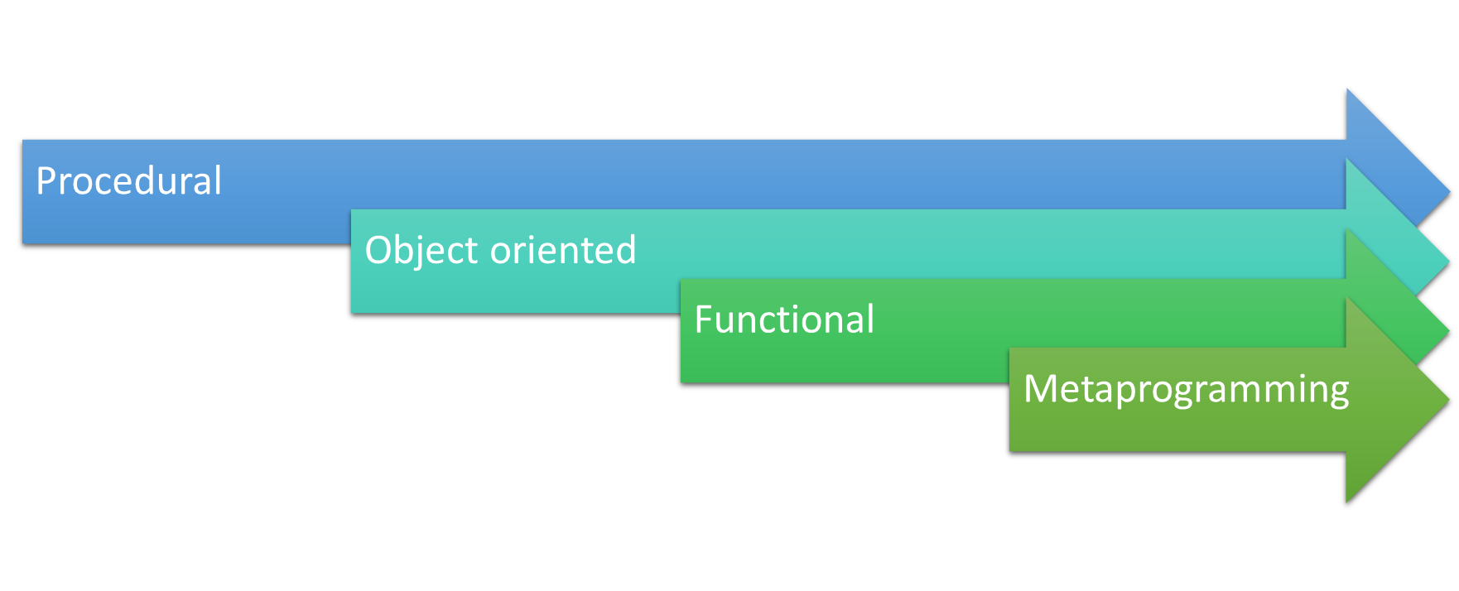
A little history

Slide 11
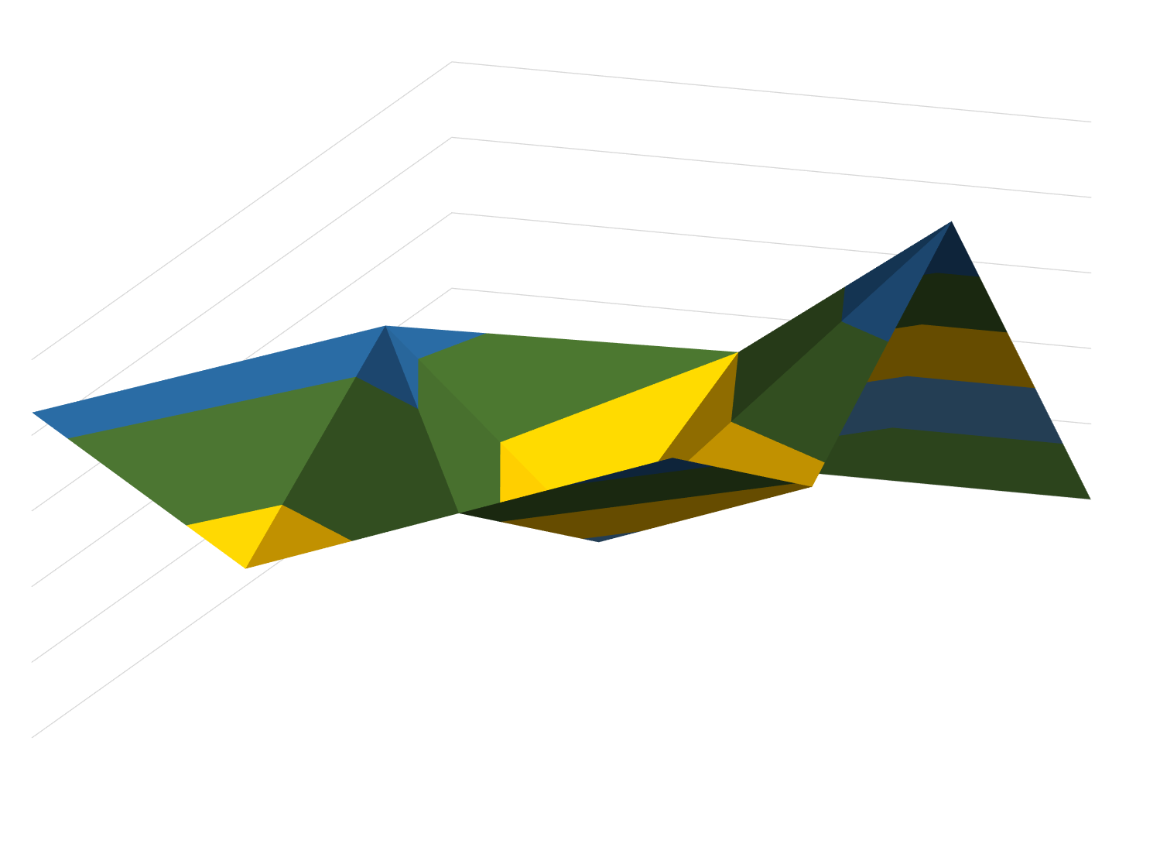
Languages are a little of this and a little of that
Procedural
Variables
Sub/function
Object Oriented
Classes
Methods
Functional
Functions as data
Metaprogramming
Scope
Data types
Inheritance
Isolation
Interchangeability
Expressions
Expressions only
Snippet/templates
Edit-time gen
Build-time gen
Reflection
Runtime gen
Pattern matching
Domain specific languages
Union types
Anonymous code
C#
F#
Strong Typing
Nulls
Immutability
Memory Management
Dynamic

Slide 12
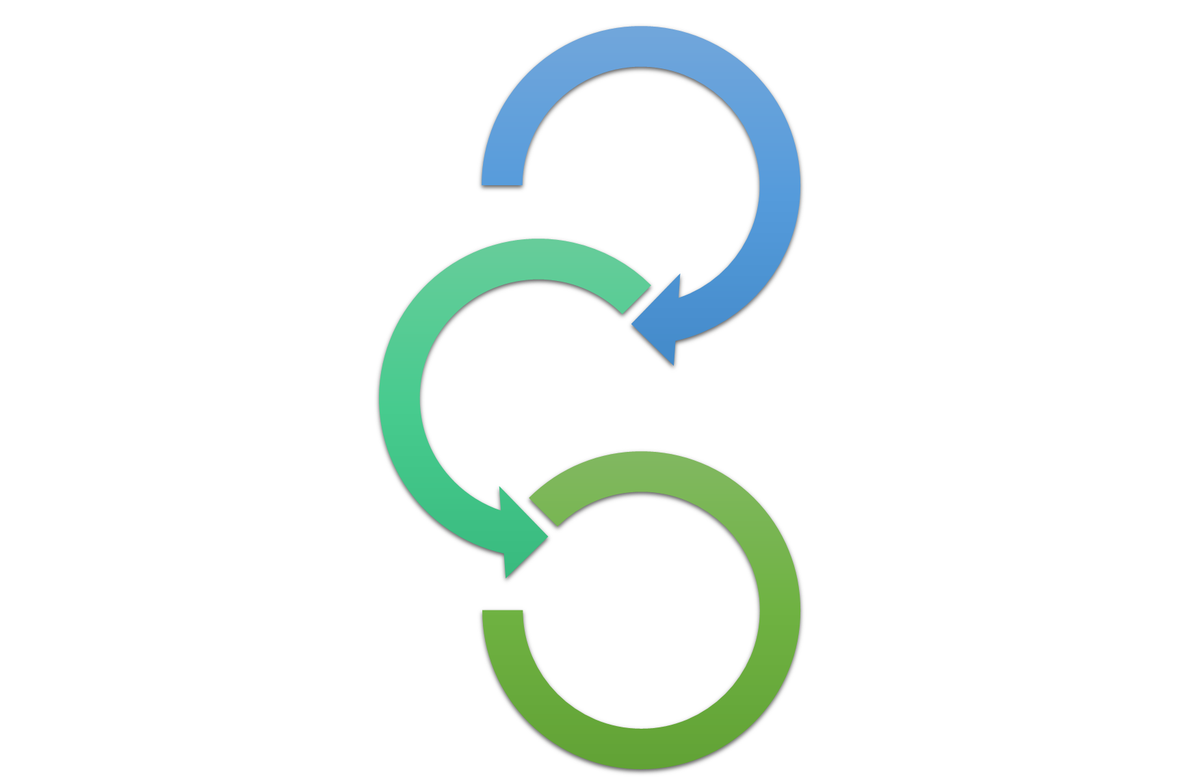
C++ and VB6
F#
C#/VB
OCaml

Slide 13
Consideration | Common options languages use | Demo
Organizational unit | Statement or expression
Line/block delimiters | Indentation or punctuation | Person record
Function call syntax | Space or comma, parentheses or not | Person.Create/Assert.Equal
Typing | Strong or weak, inferred or explicit | Person test
Comparing data | Reference or structural equality | Person test (compare lists too)
Changing data | Mutations or copying | SimpleStore
Specializing behavior | Composition or inheritance | Employee union
Varying behavior | Functions or interfaces | JsonStore and SimpleStore
The problem of nothing | Wrapper or null/absence of data | Load via Id
Errors and program flow | Report-return or throw

Slide 14
Demo 1 Person record
Create a library and a test class
Create a test for person, TDD (show non-record before record due to {}), in a module, not class
Include an int Id
Use GivenName/FamilyName as culturally first/last is ambiguous
Create a Person record so that the test passes. Allow inferred typing
Enhance
Add IsFamilyNameFirst bool member; build, test is broken
Add static Create method showing space delimited (curried) approach
Add a FullName property. If there is time, create in a module first and discuss decision
Update the test to pass
Equality
Create a static TestData function in Person with the two records from the test
Copy previous test and have first person have same names
Test for Equals
Copy that test and create two lists. If they have the same name they reassign/shadow
Add a member with a list comprehension in the test (a call to create and a loop over Testdata) to show the unequal case
You can also do this with a cons operator, but maybe postpone learning that until patterns

Slide 15
Demo 2 Employees that could be a manager
Create a test for Employee and Manager
Employee is created with a Person, and manager with a Person and Person list
Create a discriminated union
Employee and Manager where manager is a tuple
Return to the test
Use a match to deconstruct to the given name
We want a common place. Put both in the union and in a helpers module to see approaches

Slide 16
Demo 3 Loading and saving data
Create a test for simple store to store a Person
For in memory need to save/load from same instance. Use let bindings on module
Make let bindings on module for save and load functions
Test is just save/load and test.
Add in memory database
Create SimpleStore type. Primary constructor and no {} mean a class
We need to store instance data
Make store a normal let, and evolve to mutable syntax evolve to explicit Person list
Run, there are a few ways it could go wrong
Be sure you are using the same instance
Create a test for saving and loading Employees Look at comments at top in ..mid
Oops. Our SimpleStore is only for Persons. Make it generic
Now the method definitions in the test module are wrong. Create a tuple returning method for save/load
Use let deconstruction in the test. Fix it first for the other tests

Slide 17
Demo 4 A second storage type
Create a test for Json store
Copy JsonStore file
To fix the errors in tests, add the StorageFactory module
Create a discriminated union
Create a method with a match
Update the SimpleStore and JsonStore tests to use this method
This is correct by design, it cannot fail at runtime unless illegal chars in filename
The filename or connection string or whatever is created at an appropriate location
The remaining warning illustrates that correctness is the only path here

Slide 18
Stuff “on the side” in demo
Equality example
List comprehensions
Computation expression consumption
Type provider consumption
Not shown, try on your own
Load by ID from JSON returning Option type
Managing the option type

Slide 19
Stuff I really wish I had time to show you
Active patterns, and defining your own
Result type and pipelines over throwing exceptions
Task and async
Power of the FSharp libraries with features like `pairwise` and `window`
Returning to the demo and making Id an option-like with `new` member
More about types as tiny lightweight data focused classes
More on structural (records, unions and structs) vs reference (classes) equality and on F# specific equality and comparison

Slide 20
Deconstructing Object Programming
Slides in this section from Don Symes 2019 NDC, Sydney talk:
https://aka.ms/don-syme-ndc-sydney-2019

Slide 21
The 20+ features of OO
dot notation (x.Length)
instance members
type-directed name resolution
implicit constructors
static members
indexer notation arr.[x]
named arguments
optional arguments
interface types
mutable data
defining events
defining operators on types
auto properties
IDisposable, IEnumerable
type extensions
structs
delegates
enums
implementation inheritance
nulls and Unchecked.defaultof<_>
method overloading
curried method overloads
protected members
self types
wildcard types
aspect oriented programming …
…
???

Slide 22
Some make F# a better API language Some make F# a better implementation language Some are part of an interop standard Some are not needed

Slide 23
Where do we stand?
Embrace
dot notation (x.Length)
instance members
type-directed name resolution
implicit constructors
static members
indexer notation arr.[x]
named arguments
optional arguments
interface types and implementations
mutable data
operators on types
auto properties
IDisposable, IEnumerable
type extensions
events
structs
delegates
enums
type casting
large type hierarchies
implementation inheritance
nulls and Unchecked.defaultof<_>
pervasive method overloading
curried method overloads
protected members
self types
wildcard types
aspect oriented programming …
…
Down the object rabbit hole
Use where necessary, use tastefully, use respectfully, use sparingly
Not supported

Slide 24
The 20+ features of OO
Love
dot notation (x.Length)
instance members
type-directed name resolution
implicit constructors
static members
indexer notation arr.[x]
named arguments
optional arguments
interface types and implementations
mutable data
operators on types
auto properties
IDisposable, IEnumerable
type extensions
events
structs
delegates
enums
type casting
large type hierarchies
implementation inheritance
nulls and Unchecked.defaultof<_>
pervasive method overloading
curried method overloads
protected members
self types
wildcard types
aspect oriented programming …
…
Mostly Avoid
Tolerate
Forget

Slide 25
Object Programming v. Object-Oriented Programming

Slide 26
Object Programming focuses on … succinct coding, notational convenience API ergonomics good naming practical encapsulation sensible, small, composable abstractions expression-oriented making simple things out of (potentially complex) foundations

Slide 27
In the extreme Object-Oriented Programming can be… objects as a single paradigm hierarchical classification (Animal, Cat, Dog, AbstractJellyBeanFactoryDelegator) large abstractions with many holes and failure points declarations not expressions composition through… more hierarchies

Slide 28
The F# approach is to embrace object programming, make it fit with the expression-oriented typed functional paradigm but not embrace full “object-orientation” (unless you happen to be in a project using that technique)

Slide 29
Resources
@KathleenDollard on Twitter
https://github.com/KathleenDollard/DevIntersection2022
For slides, materials and links
https://github.com/KathleenDollard/fsharp-demo
For demo code

Slide 30
Demo 5 A parse tree from a computation expression

Slide 31
Pain points
Init scope
File and code ordering
Compiler error messages (so sorry, they used to be worse)
CE errors are a disaster
Parentheses for grouping, sometimes where you don’t expect it
Watch the squiggles, like in “Not a function..cannot be applied”
Visual Studio debugging is with C# syntax – watch `=`, for example
Hover to check types, or specify them at least temporarily

Slide 32
Records vs classes
Do you want structural or reference equality?
Manually adding structural equality is prone to errors, unless just an ID
Mixing structural and reference equality may give headaches
When do you use a record?
Is the internal representation = external representation
If your records adds many properties, then maybe not a record
In both F# and C#, storage is a separate concept than equality
Struct vs classes generally requires profiling
For most code, most of the time, classes are fine
Notes:
The layout of this slide is against blank so that we can group. Do not change this.
This is separate from the next because we cannot group until we finish the animations

Slide 33
Records vs classes
Do you want structural or reference equality?
Manually adding structural equality is prone to errors, unless just an ID
Mixing structural and reference equality may give headaches
When do you use a record?
Is the internal representation = external representation
If your records adds many properties, then maybe not a record
In both F# and C#, storage is a separate concept than equality
Struct vs classes generally requires profiling
For most code, most of the time, classes are fine
Notes:
This slide is needed to group prior to the animation

Slide 34




Class
Struct
Record (class)
Record Struct
Consider using only when there is special equality
Records vs classes
Do you want structural or reference equality?
Manually adding structural equality is prone to errors, unless just an ID
Mixing structural and reference equality may give headaches
When do you use a record?
Is the internal representation = external representation
If your records adds many properties, then maybe not a record
In both F# and C#, storage is a separate concept than equality
Struct vs classes generally requires profiling
For most code, most of the time, classes are fine
Heap
Stack

Slide 35
Don’t forget to complete an online
Session Name
Your evaluation helps organizers build better conferences and helps speakers improve their sessions.
Thank you!

Slide 36
FOR INFORMATION ABOUT OUR NEXT IN PERSON EVENT, VISIT OUR WEBSITE AT

Slide 37
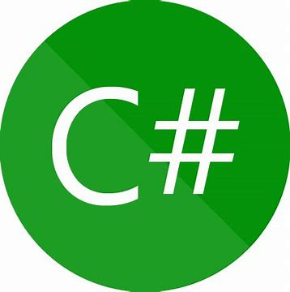

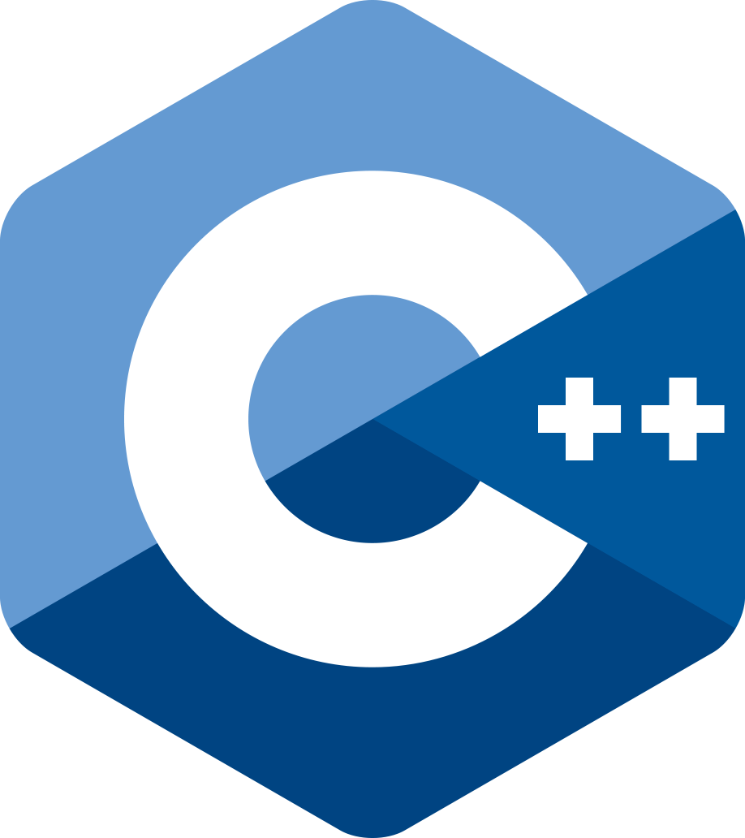



F#

